Slide 1

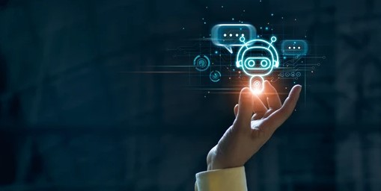

PROJECT ON chatbot
BY
SUMIT DAS
DEBAJYOTI SEN
PRERNA KUMARI
NAYAN KUMAR MANDAL
BIKY ROY

Slide 2
CHATBOT
A chatbot is a computer program that uses
Artificial intelligence (AI) and natural language
Processing (NLP) to understand customer
questions and automate responses to them,
simulating human conversation.

Slide 3
Abstract
The ppt explains the working of an ChatBot, which contains data produced by an AI ChatBot. ChatBot is defined as a P2P platform. It takes user input and queries from the user and replies to it accordingly. An AI ChatBot is a feature which is seen to take over the world mostly in near future. Since the industry is booming and expected to grow shortly.

Slide 4
Libraries Used
1. Pandas
pandas is a software library written for the Python programming language for data
manipulation and analysis. In particular, it offers data structures and operations for
manipulating numerical tables and time series.
2. Nltk
Natural Language Tool Kit – or NLTK – is an open source suite
of libraries and programs for building programs in Python
language.
3. Json
it is a standard text-based format for representing structured data based on
JavaScript object syntax.
4. Pickle
Python pickle module is used for serializing and de-serializing python object structures.
The process to converts any kind of python objects (list, dict, etc.) into byte streams (0s
and 1s) is called pickling or serialization or flattening or marshalling. We can converts
e byte stream (generated through pickling) back into python objects by a process called
as unpickling.

Slide 5
Application
A chatbot is a computer program that uses artificial intelligence (AI) and natural
language processing (NLP) to understand customer questions and automate
responses to them, simulating human conversation.
In most Countries, students use chatbot for schoolwork(like chatGPT).
It makes the work easy and it also gives suggestion to the users as per there
requirements. It also can be used as mathematical calculator.

Slide 6
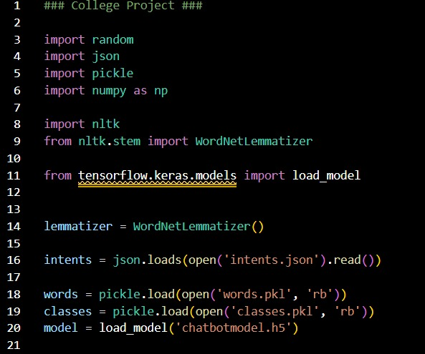
MODULES USED

Slide 7
Problems faced while coding
The code was not running initially due to the lack of required modules and library packages not being installed in the system.
There were a few syntax error in the code as well which were resolved.

Slide 8
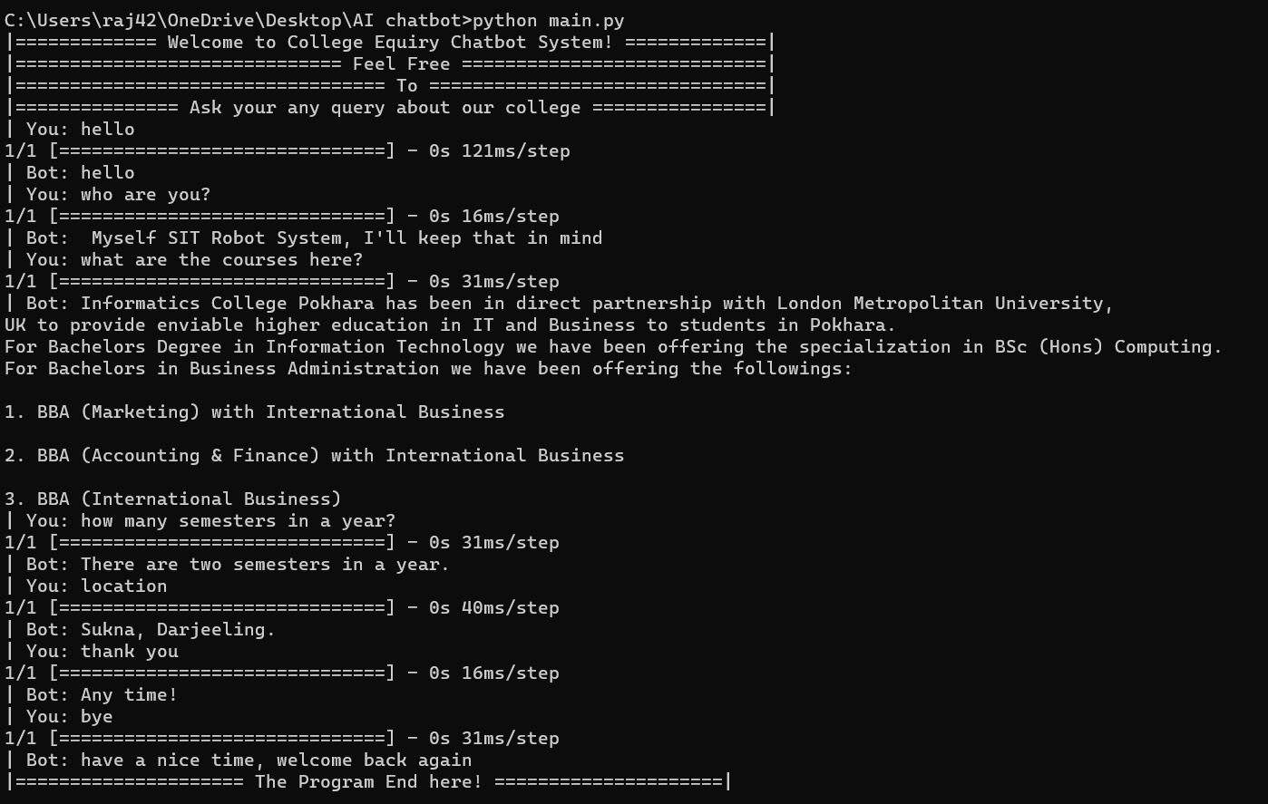
OUTPUT

Slide 9
FUTURE SCOPE OF THE PROJECT
Chatbots are already good at understanding complex
human conversations, and 2023 will be the year that this
trend will continue. Chatbots can understand more
enhanced conversations and respond in a much more
“human” way. In fact, the responses will get so good
that, at one point, users may not even want to enable the
“bot-to-human-handoff” feature. Sentiment analysis and
emotion detection features of the bots will become more
accurate and sophisticated. Social media monitoring will be
much easier for companies with NLP-powered bots that can
detect and respond to negative reviews and comments.

Slide 10
REFERENCE
https://www.chatbot.com
https://www.oracle.com/in/chatbots/what-is-a-chatbot
https://en.wikipedia.org/wiki/Chatbot

Slide 11
THANK YOU

